Slide 1
Design Patterns
The State

Slide 2
Title slide
Text Here
Bullet point formatting
Color wheeee
Other color whooo

Slide 3
Application state
Current knowledge

Slide 4
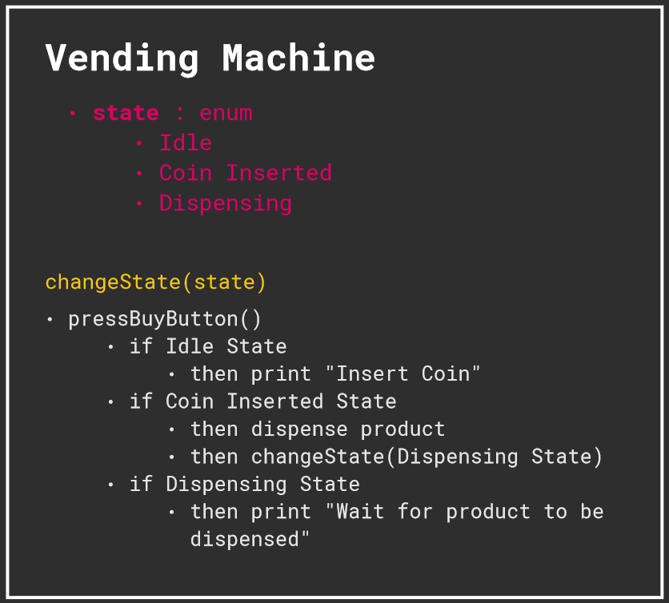
Vending machine example

Slide 5
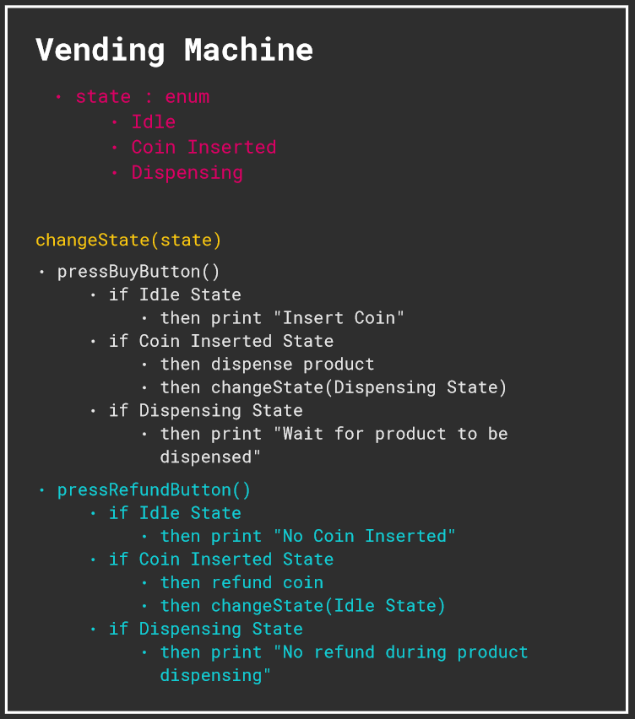
Adding one method

Slide 6
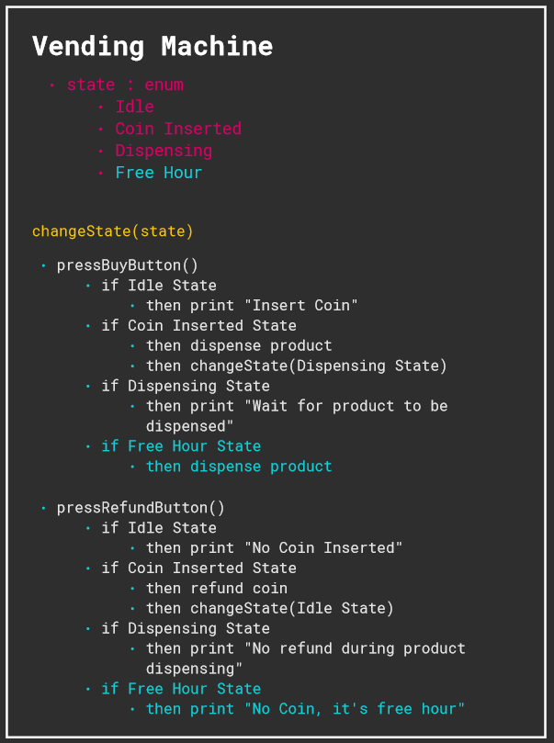
… and another state

Slide 7
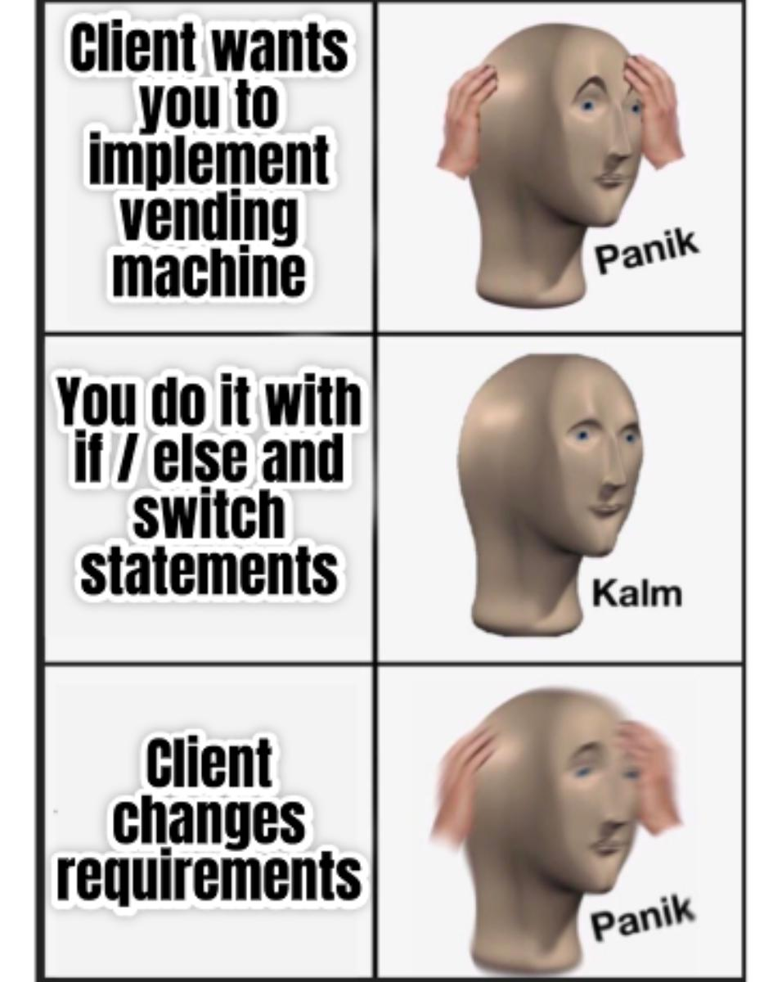
Managing complex states in one class
Nested if / else
Hard to maintain code
Very hard to scale

Slide 8
Application state
Using design pattern

Slide 9
What is a State design pattern ?
Object with its own state
which have different behaviors
depending on its state

Slide 10
How to avoid the identified problems ?
First step :
Removing code that perform actions from the object to state classes

Slide 11
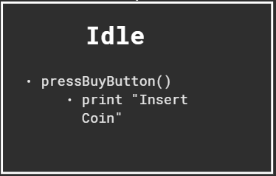
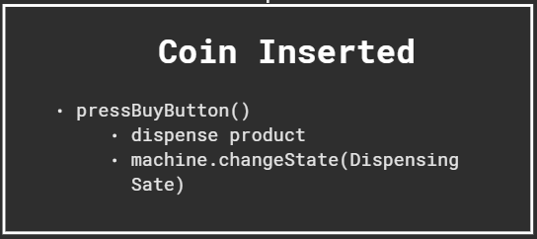
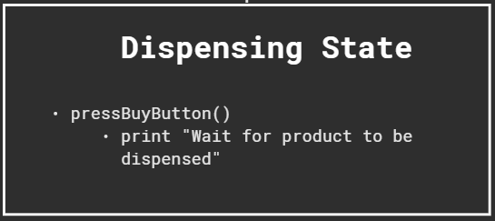
How to avoid the identified problems ?

Slide 12
How to avoid the identified problems ?
First step :
Removing code that perform actions from the object to state classes
Second step :
Create an interface that represent the different actions of the object

Slide 13
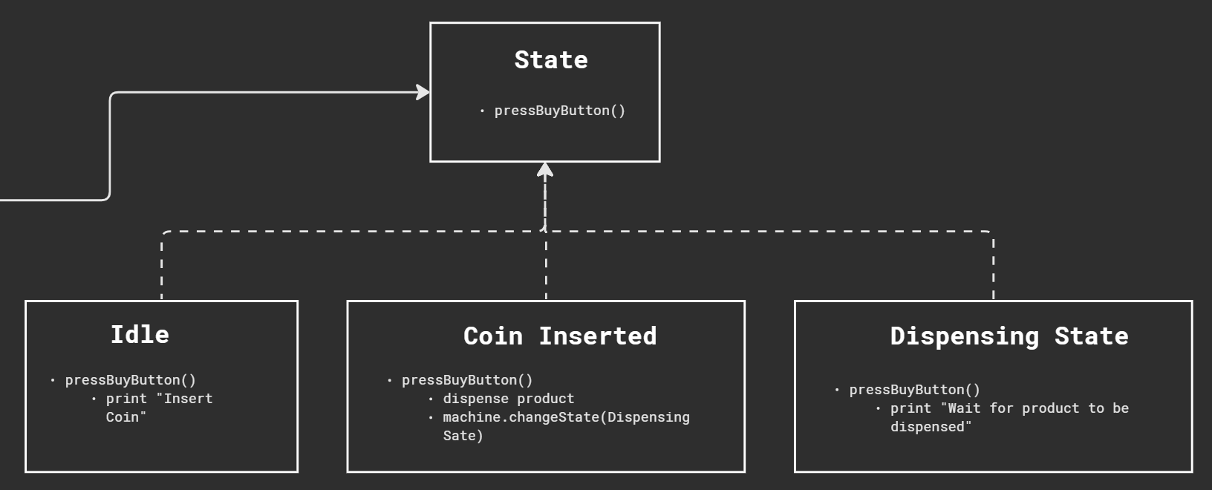
How to avoid the identified problems ?

Slide 14
How to avoid the identified problems ?
First step :
Removing code that perform actions from the object to state classes
Second step :
Create an interface that represent the different actions of the object
Final step :
Use polymorphism to link the object with the different states

Slide 15
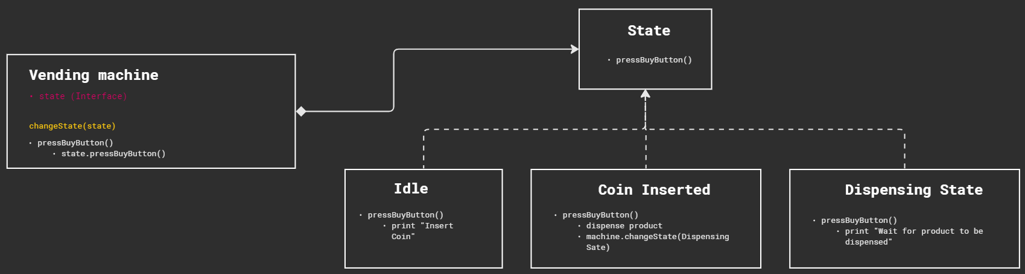
How to avoid the identified problems ?

Slide 16
Refactoring
Using the State pattern

Slide 17
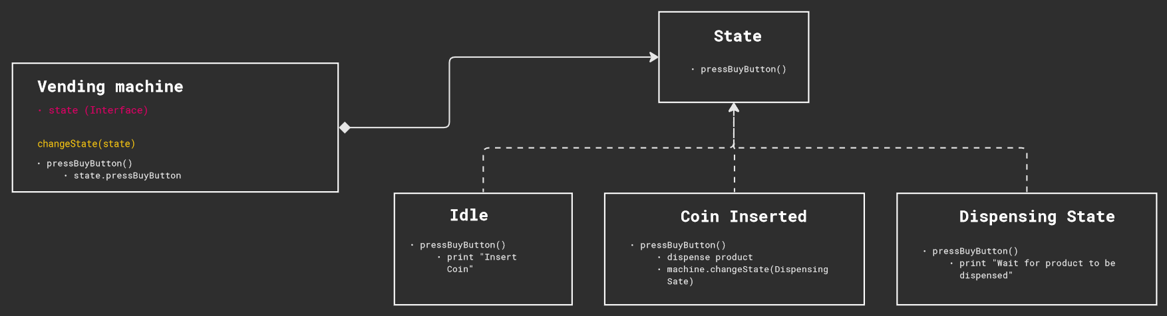
Refactoring with state: initial situation

Slide 18
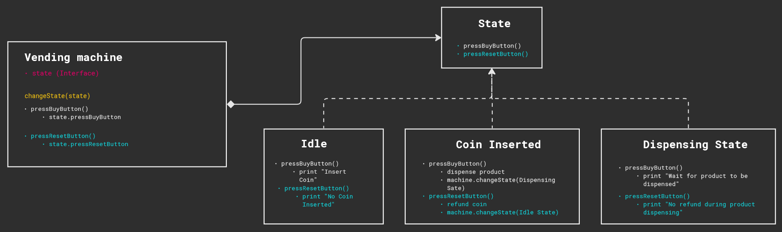
Refactoring with state: adding a method

Slide 19
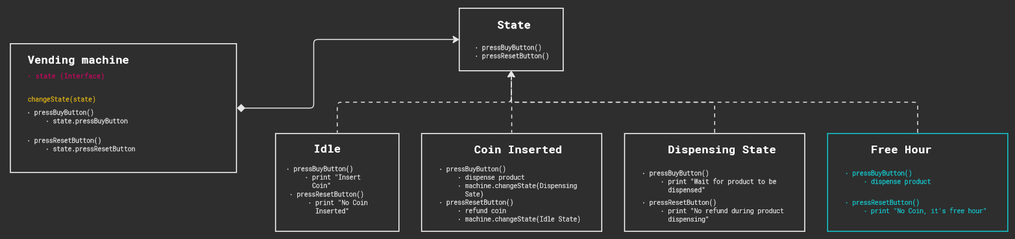
Refactoring with state: adding a state

Slide 20
Pros & Cons

Slide 21
Pros
Cons
SRP
Open/Closed Principle
Simplified Context
Maintainability, scalability, readability
The pattern can be overkill :
Adds complexity
Many classes
Performance (memory)

Slide 22
Thank you !
Any question ?

Slide 23
Title slide
template

Slide 24
Title slide - template
Text Here
Bullet point formatting
Color wheeee
Other color whooo

